Slide 1


Instant Health Alert System

Slide 2
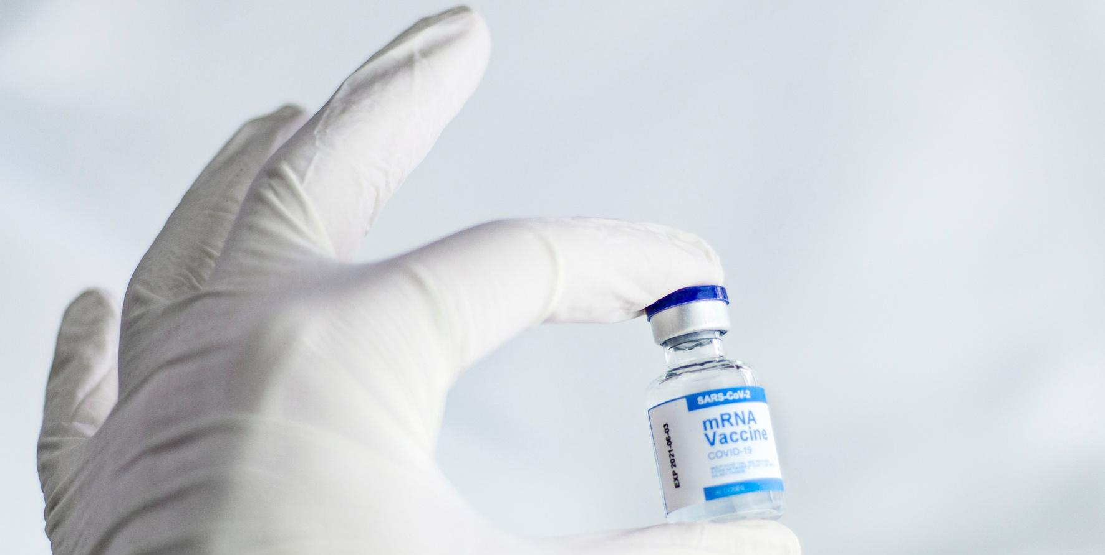
a) Healthcare monitoring at hospitals has witnessed new challenges. In view of these challenges, this use case proposes a reliable data pipeline solution to store and analyze a stream of real-time data flowing from various IoT devices at hospitals and health centers.
b) The advent of IoT devices has digitized vital health data such as body temperature, heartbeat, blood pressure (BP) and more. Capturing this high-velocity stream of data and analyzing these in real-time with minimal error is only possible with the use of a robust data platform and components.
Problem Statement

Slide 3
01.
Patient's Contact Info Dataset Schema
Table of
Contents
02.
Threshold Reference Table Schema
03.
Patient's Vital Info Dataset Schema

Slide 4
Real-time alert notification system
performing the following tasks:
Taking streaming data (patients vital information) and storing it in a table
Taking batch data (patients contact information) and storing it in a table
Comparing the vital information with threshold information and analyzing.
Sending notifications if the data is out of the threshold limits
a. This use case will simulate the streaming vital data of patients and building of a data pipeline to monitor vital data to alert the subscribers in real-time based on reference data
b. If the vital information coming from the patient is out of the normal threshold range, an alert notification will have to be sent immediately to the registered Email-ID

Slide 5
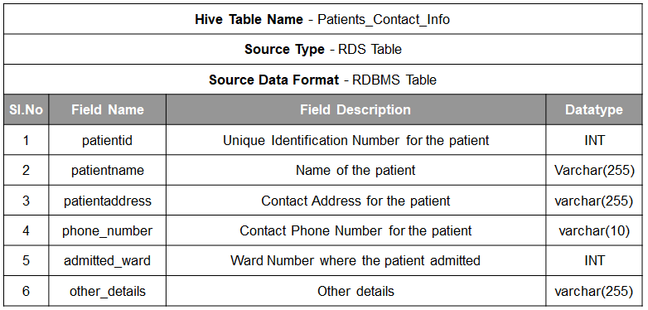
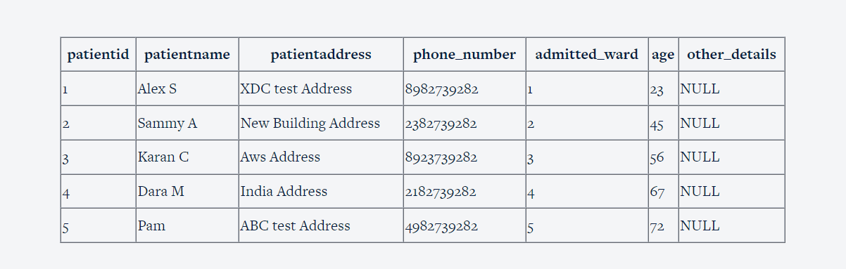
Patient's Contact Info Dataset Schema

Slide 6

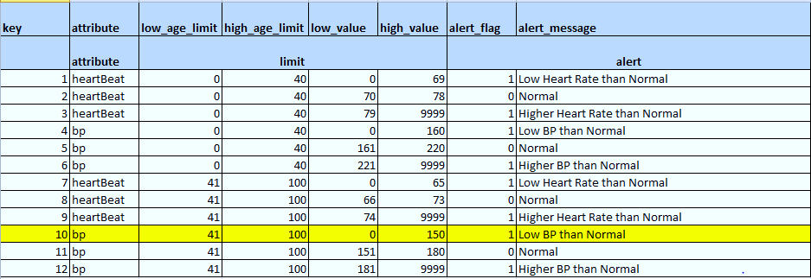
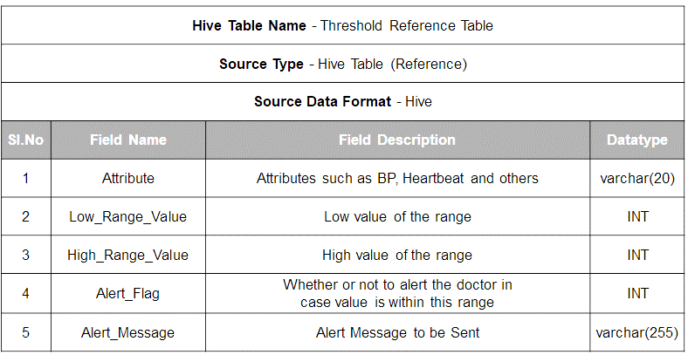
Threshold Reference Table Schema

Slide 7
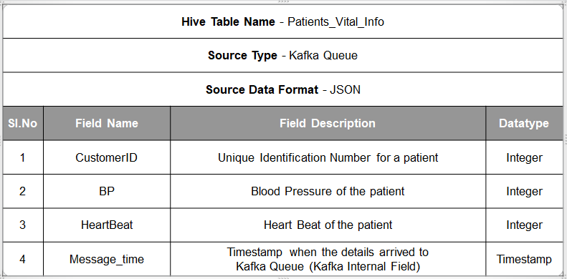
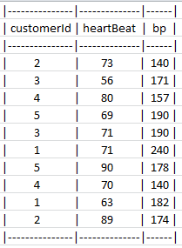
Patient's Vital Info Dataset Schema

Slide 8

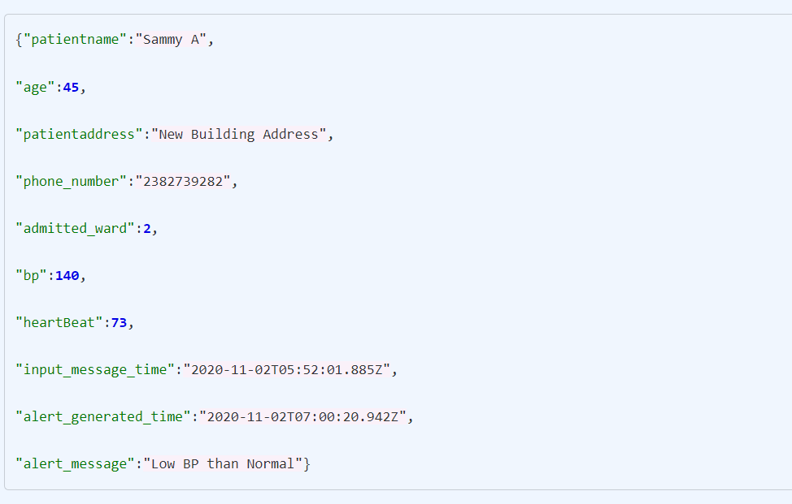
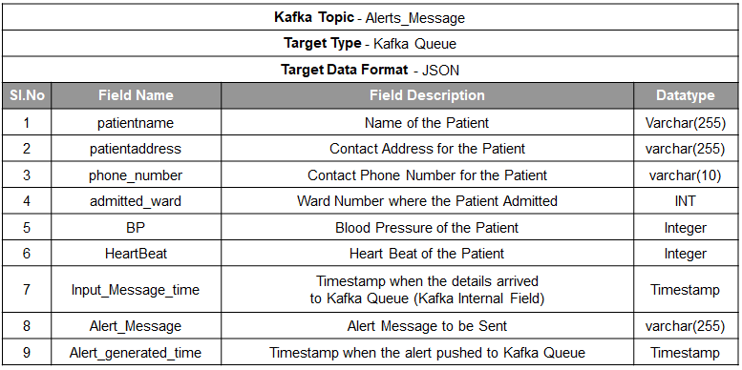
OUTPUT

Slide 9
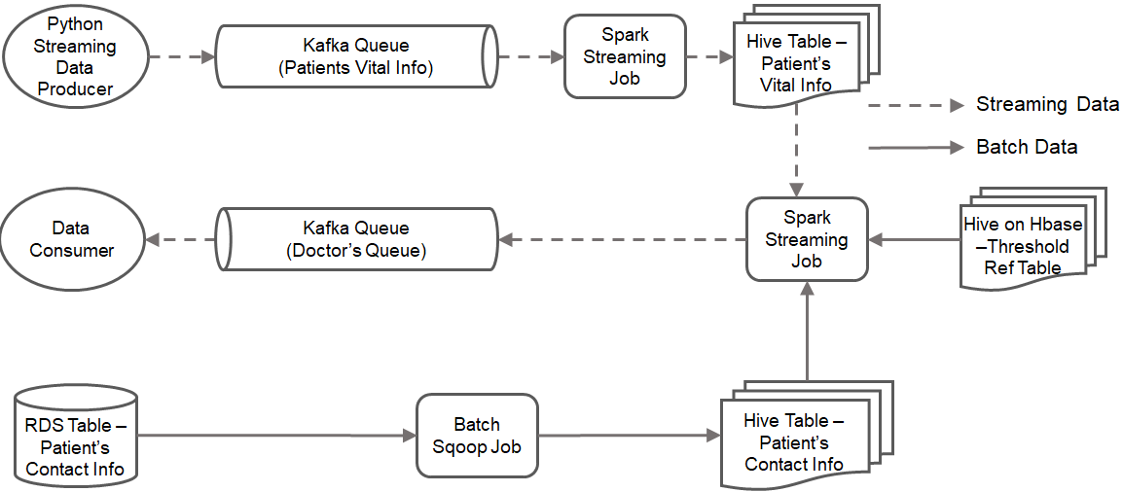
DATAFLOW

Slide 10
Solution Approach and tasks
a) Producer app: It simulates IoT devices to push data through to the Kafka queue and will generate vital information and push it in the JSON format into the Kafka Queue. Eg: {"heartBeat": 73, "bp": 140, "customerId": 2}
b) Kafka Queue (Patient’s): It stores the data pushed into it by the producer in a pipeline to send it further to the next component.
c) Spark Streaming Job 1: To convert data into the desired form (parquet) and store it into the HDFS table.
d) Hive Table (Patient’s Info): Query the table data and do analysis.
e) Spark Streaming Job 2: Monitoring and analyzing the data collected using already present data (Reference Table and Contact Info) and look for any anomalies to be reported.
f) Hive Table (Reference)- Store and query threshold data to check whether incoming data have any anomalies.
g) RDS + Batch Sqoop Job: Push the contact data of the patients from RDS into the Hive table.
h) Hive Table (Contact Info): Store and query contact and other information to check whether incoming data have any anomalies.
i) Kafka Queue (Doctor’s)-Collect data from Spark application to put in a queue and feed to Consumer application
j) Consumer Application- Send SNS push notification to the subscribed email-id to report any anomalies.

Slide 11


Conclusion
1.It will reduce the patient's risk.
2.Send and deliver emergency alerts faster.
3.Check staff safety and Focus Crisis Response efforts.
4.Improve Emergency Response Plans and Process
5.Save time and Increase notification efficiency.
6.Communicates with Target Patient’s.

Slide 12
Thank you!

